Slide 1
CTF model for long reverberation Date：2022. 05. 17
Telecom Electroacoustics Audio(TEA) Lab
Presenter:
Anchi Yuan
Notes:
Hello everyone
I’m today’s presenter siang. I’m going to share some of my present work in source separation problem. My topic is comparative studies of source separation using semi-blind and blind source separation approaches.

Slide 2
Outline
Simulation setting
Specify parameter
ATF estimation
Source prediction
Conclusion
Future work

Slide 3
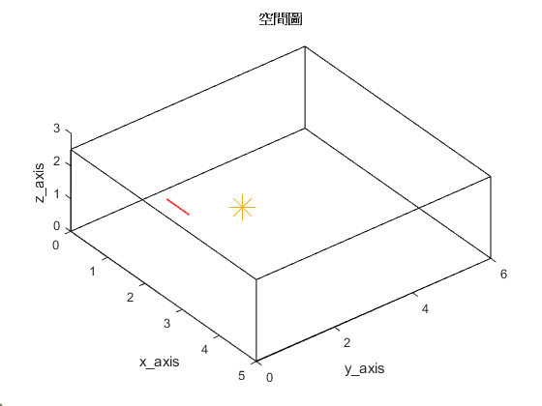
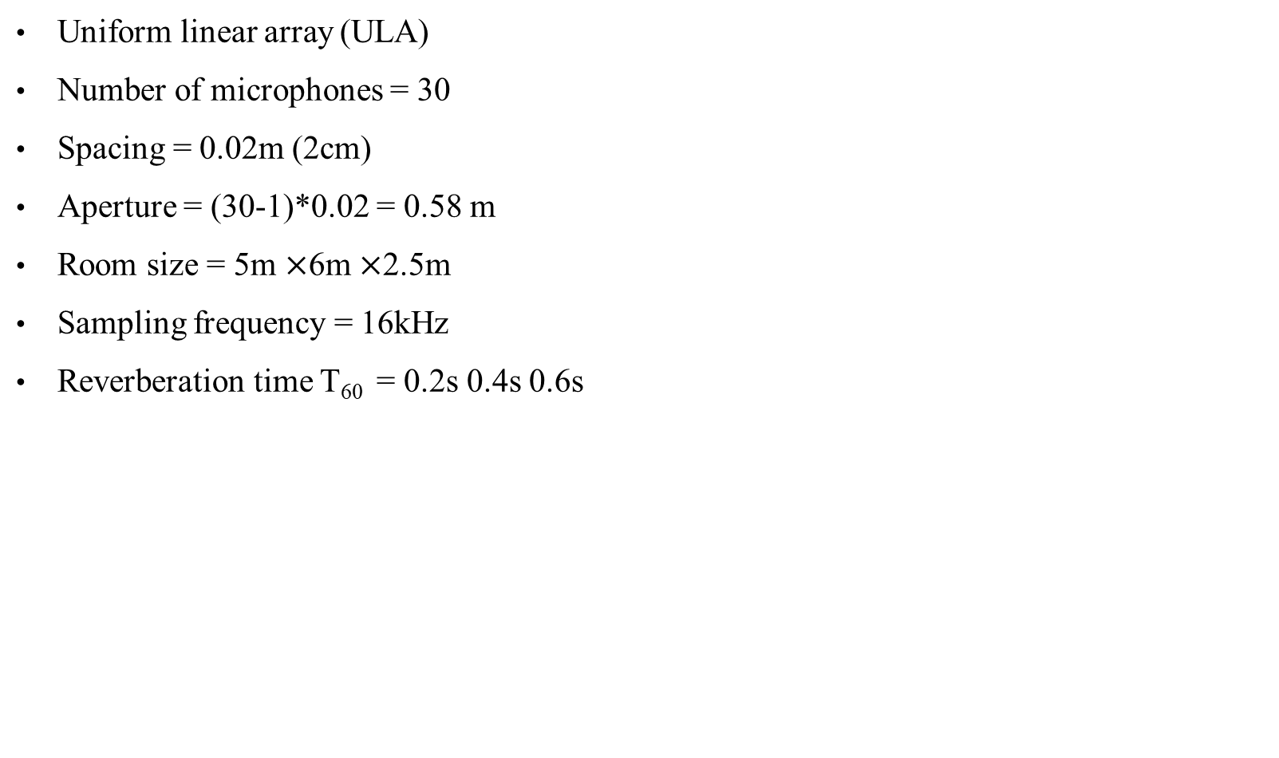
Simulation setting
Uniform linear array (ULA)
Number of microphones = 30
Spacing = 0.02m (2cm)
Aperture = (30-1)*0.02 = 0.58 m
Room size = 5m $×$6m $×$2.5m
Sampling frequency = 16kHz
Reverberation time T₆₀ = 0.2s 0.4s 0.6s
First microphone location [1, 1.5, 1]
2.5m
origin
Source location [2, 2.6, 1]
5m
6m

Slide 4
Specify parameter
Time domain convolution |  |  | ATF pts | NWIN_H | hopsize_H
 |  |  |  | 64 | 64
 |  |  | Source pts | NWIN | hopsize
 |  |  |  | 2048 | 64
time |  |  | ATF with short window, source with long window (Ref)
ATF pts | NWIN_H | hopsize_H | ATF pts | NWIN_H | hopsize_H
 | 64 | 32 |  | 2048 | 1024
Source pts | NWIN | hopsize | Source pts | NWIN | hopsize
 | 64 | 32 |  | 2048 | 1024
both short window with half hopsize |  |  | both long window with half hopsize

Slide 5
ATF estimation (1)
Cosine similarity = 0.8756
Ground-truth RIR
T₆₀ = 0.2s
Ref
Cosine similarity = 0.8932
Cosine similarity = 0.9607
both short window with half hopsize
both long window with half hopsize

Slide 6
ATF estimation (2)
Cosine similarity = 0.7466
Ground-truth RIR
T₆₀ = 0.4s
Ref
Cosine similarity = 0.8438
Cosine similarity = 0.8364
both short window with half hopsize
both long window with half hopsize

Slide 7
ATF estimation (3)
Cosine similarity = 0.6531
Ground-truth RIR
T₆₀ = 0.6s
Ref
Cosine similarity = 0.8044
Cosine similarity = 0.8215
both short window with half hopsize
both long window with half hopsize

Slide 8

Source prediction
ground-truth source
 |  | Ref | both short window with half hopsize | both long window with half hopsize
T₆₀ = 0.2 | R_{ss}R_{sy} initialize with ground-truth source
 | R_{ss}R_{sy} initialize with DAS
T₆₀ = 0.4 | R_{ss}R_{sy} initialize with ground-truth source
 | R_{ss}R_{sy} initialize with DAS
T₆₀ = 0.6 | R_{ss}R_{sy} initialize with ground-truth source
 | R_{ss}R_{sy} initialize with DAS

Slide 9
Conclusion
If window length is long enough compared with reverberation time, ATF estimation will peform precisely for first frame, also source prediction will peform satisfactorily.
Because Rss Rsy initialize with DAS is limited by NFFT, it will peform terribly for long reverberation time.

Slide 10
Future work
multiple-input/output inverse theorem (MINT)
Blind system ID → Benesty’s approaches

Slide 11


